Slide 1
Creation of Components and CSS
DisplaySection.js + DisplaySection.module.css
ExpenseItemContainer.js + ExpenseItemContainer.module.css
ExpenseForm.js + ExpenseForm.module.css
ExpenseItemTableCard.js + ExpenseItemTableCard.module.css

Slide 2
Project Tree
App.js
DisplaySection.js
ExpenseForm.js
ExpenseItem
Container.js
Expense
ItemTableCard.js
Remove Button
onClick

Slide 3
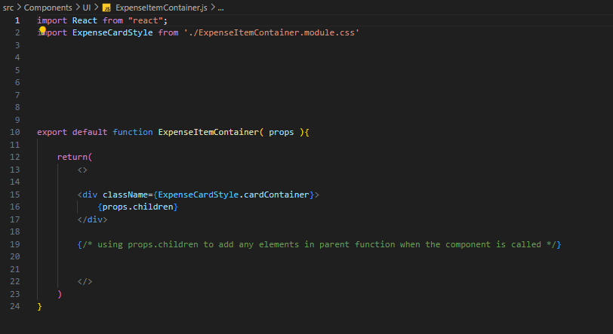
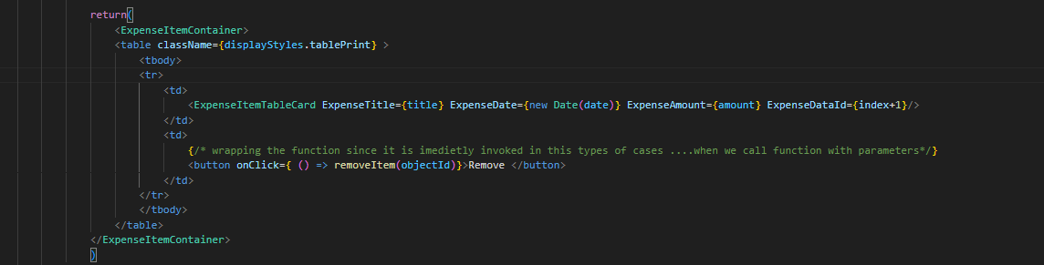
ExpenseItemContainer.js
In this component
We import React from react
We create a div which is used to wrap the
Other components in it (Nested Component).
So we pass props.children which will copy all
The elements wrapped within it and display it .

Slide 4
Components in Brief

Slide 5
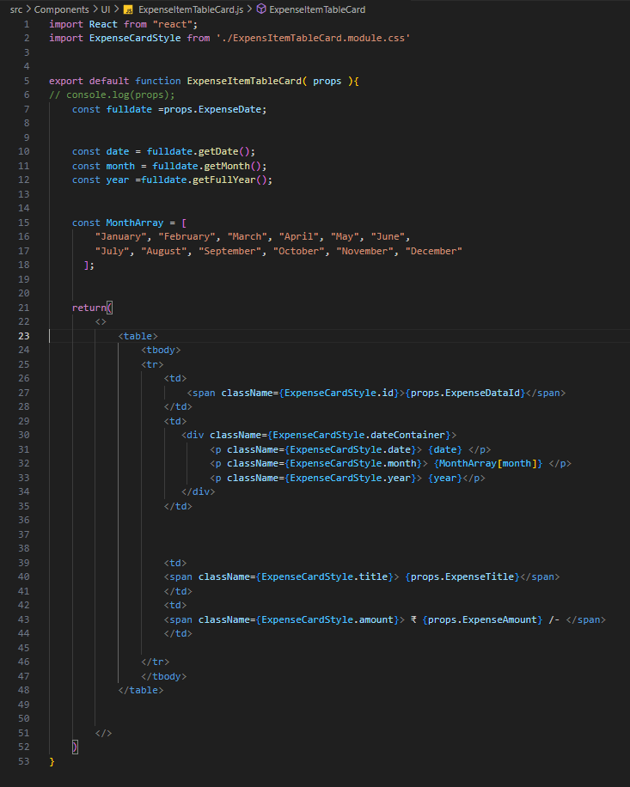

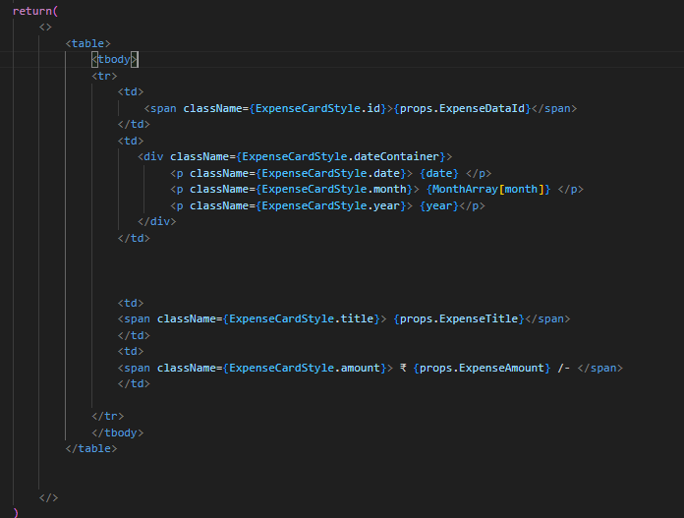
ExpenseItemTableCard.js
Through props we have received a date object from which by date methods
We fetch date ( .getDate() ) , month ( .getMonth() ) , year ( .getFullYear() )
getMonth() returns Month in numbers where 0= January and 11 = December
We have created a array of months to display the name of months instead of year .. So if it is November it will return 10 and that no will search 10th index in array and print November
Then we print the
values received by props
from parent
DisplaySection.js
In their respective
position

Slide 6
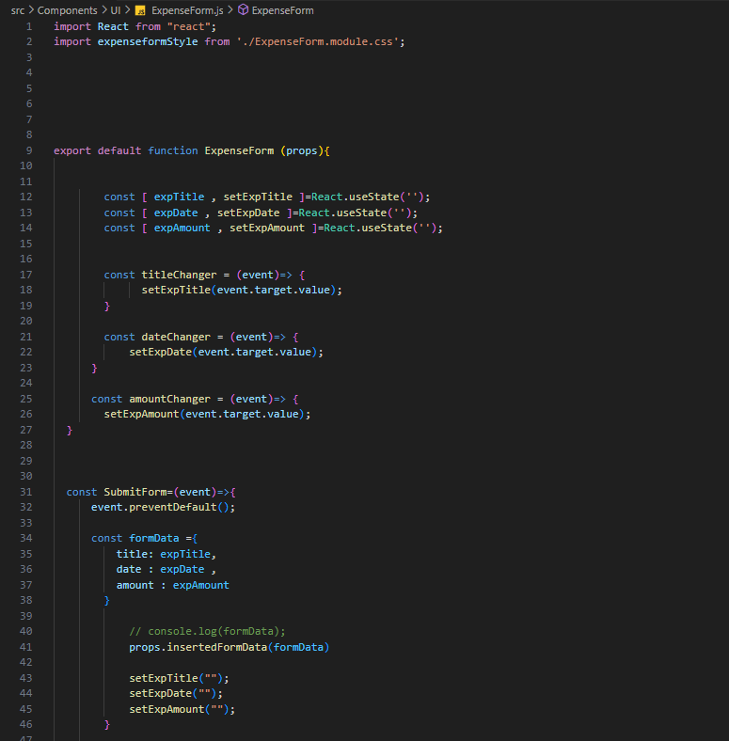
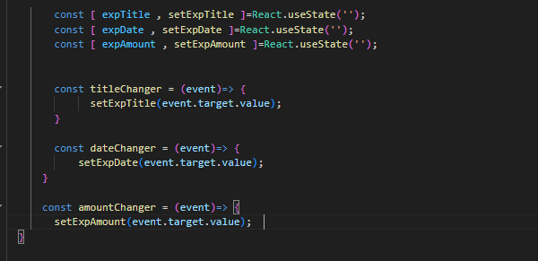
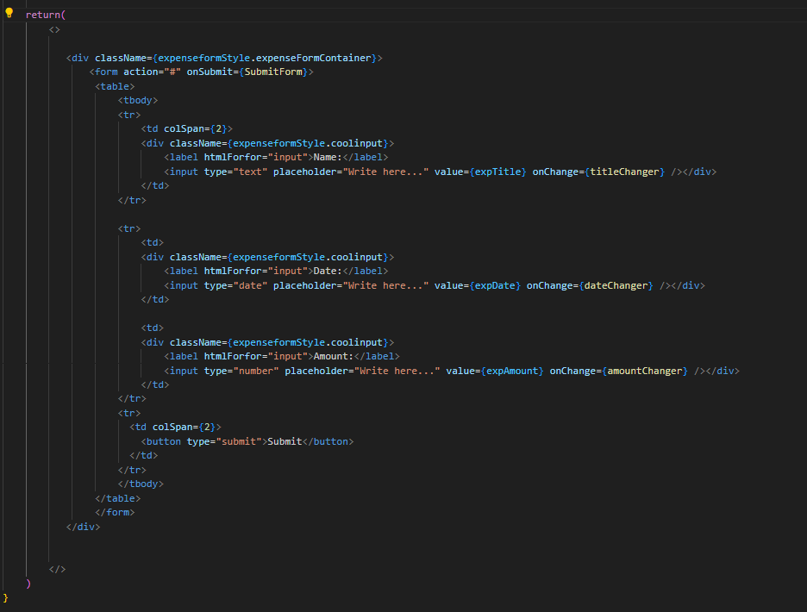

ExpenseForm.js
Importing of React Library.
Creating dynamic variable to store form Expense input field data by useState
Initializing useState by blank fields .
Since we initialise the use State of inputs by blank we are unable to change the valueor insert as it immediately turns the value inserted by blank …. without rendering….
To get rid or solve the above problem we use onChange event on input fields… to update te input field variables by the function provided in useState… through the event object passed in onchange function which captures all event performed in fields…..
Event.target.value
On clicking submit button we collect
The input field values in a object
formData and send the data to
DisplaySection.js through a function passed to ExpenseForm.js .
Sending of function to ExpenseForm.js from DisplaySection.js
Sending of value of input fields to DisplaySection.js from ExpenseForm.js by the function send to ExpenseForm.js through Props.

Slide 7
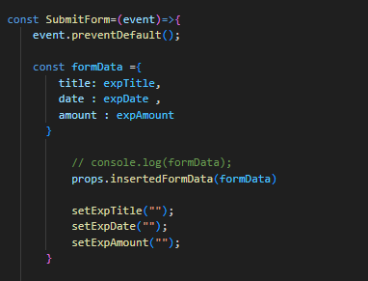
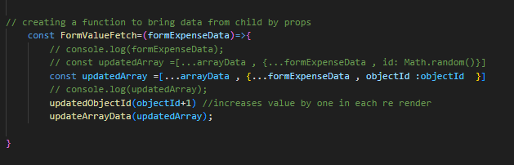
Data Sending From ExpenseForm.js to DisplaySection.js ExpenseForm.js -> Child DisplaySection.js -> Parent [SENDING DATA FROM CHILD TO PARENT]
Saving and collecting the data in form of object and passing it to parent by props .
In DisplaySection.js we receive the data through a function --- copy the data .. Assign a unique id to object by creating it through use state ....
Then we copy the existing array and the add the data of form received through props….
And update the array by useState update function.
Function sending by props to bring data from child to parent
Operations performed after getting the data
Props.insertedFormData(name of object where the data is collectively passed)

Slide 8

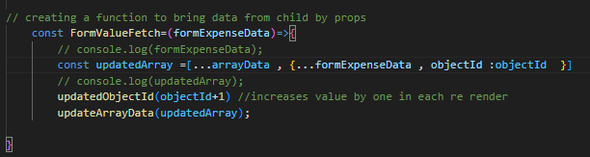
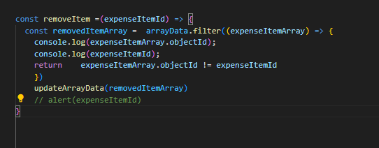
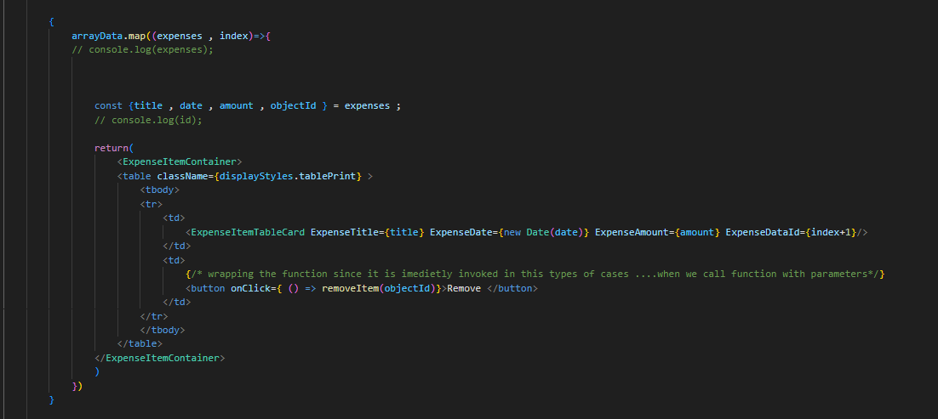
DisplaySection.js
State Initialization: An empty array named FormDataArray is created.
State Hooks: Two state variables, arrayData and objectId, are declared using the useState hook. arrayData is initialized with the empty array FormDataArray, and objectId is initialized with 0.
FormValueFetch Function: FormValueFetch is a function that takes formExpenseData as an argument. It updates the arrayData state by adding a new object derived from formExpenseData with an additional objectId property in existing array by coping the existing array with spread operator. The objectId state is then incremented by 1.
removeItem is a function that takes an expenseItemId and filters the arrayData to create a new array excluding the item with the specified objectId. The filtered array is then set as the new state for arrayData by updateArrayData
Render Method: The component renders an ExpenseForm component, passing the FormValueFetch function as a prop.
The component then maps over the arrayData array, rendering an ExpenseItemContainer for each item. Each item includes a "Remove" button that, when clicked, calls the removeItem function with the corresponding objectId.
This component appears to be part of an expense tracking application, where expenses can be added and removed dynamically. The arrayData state maintains the list of expenses, and the FormValueFetch function is used to add new expenses, while the removeItem function is used to remove expenses.

